Slide 1
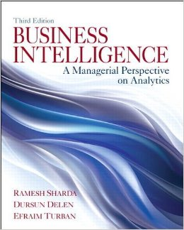
Business Intelligence: A Managerial Perspective on Analytics (3rd Edition)
Chapter 7:
Business Analytics: Emerging Trends and Future Impacts

Slide 2
Location-Based Analytics
Geospatial Analytics
Geocoding
Visual maps
Postal codes
Latitude & Longitude
Enables aggregate view of a large geographic area
Integrate “where” into customer view

Slide 3
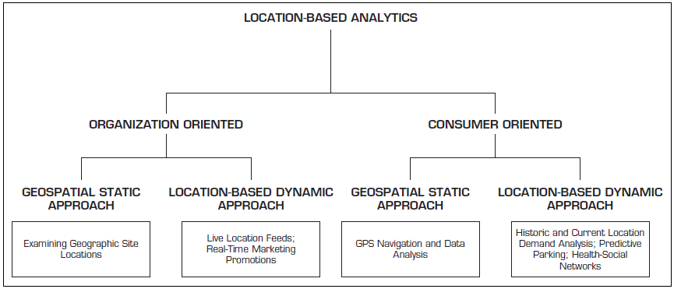
Location-Based Analytics

Slide 4
Location-Based Analytics
Location-based databases
Geographic Information System (GIS)
Used to capture, store, analyze, and manage the data linked to a location
Combined with integrated sensor technologies and global positioning systems (GPS)
Location Intelligence (LI)?
Interactive maps that further drill down to details about any location

Slide 5
Use of Location-Based Analytics
Retailers – location + demographic details combined with other transactional data can help …
determine how sales vary by population level
assess locational proximity to other competitors and their offerings
assess the demand variations and efficiency of supply chain operations
analyze customer needs and complaints
better target different customer segments

Slide 6
Real-Time Location Intelligence
Many devices are constantly sending out their location information
Cars, airplanes, ships, mobile phones, cameras, navigation systems, …
GPS, Wi-Fi, RFID, cell tower triangulation
Reality mining?
Real-time location information = real-time insight
Path Intelligence (Mall outlet statistics)
Footpath – movement patterns within a city or store
How to use such movement information

Slide 7
Analytics Applications for Consumers
Explosive growth of the apps industry
iOS, Android, Windows, Blackberry, Amazon, …
Directly used by consumers (not businesses)
Enabling consumers to become more efficient
Interesting Examples
CabSense – finding a taxi in New York City
Rating of street corners; interactive maps, …
ParkPGH – finding a parking spot
Downtown Pittsburgh, Pennsylvania

Slide 8
Other Analytics-Based Applications
Productivity
Cloze – email in-box management
Intelligently prioritizes and categorizes emails
The demand and the supply for consumer-oriented analytic apps are increasing
Value estimates place the app industry already at $25 billion
Privacy concerns?

Slide 9
Recommendation Engines
People rely on recommendations by others
Success for retailer line Amazon.com
Recommender systems
Web-based information filtering system that takes the inputs from users and then aggregates the inputs to provide recommendations for other users in their product or service selection choices
Data
Structured → ratings/rankings
Unstructured → textual comments

Slide 10
Recommendation Engines
Two main approaches for recommendation systems
Collaborative filtering
Based on previous users’ purchase/view/rating data
Collectively deriving user ⬄ item profiling
Use this knowledge for item recommendations
Disadvantage – requires huge amount of historic data
Content filtering
Based on specifications/characteristics of items (not just ratings)
First, characteristics of an item are profiled, and then the content-based individual user profiles are built
Recommendations are made if there are similarities found in the item characteristics

Slide 11
The Web 2.0 Revolution and Online Social Networking
Web 2.0?
Advanced Web - blogs, wikis, RSS, mashups, user-generated content, and social networks
Objective – enhance creativity, information sharing, and collaboration
Changing the Web from passive to active
Consumer is the one that creates the content
Redefining what is on the Web as well as how it works
Companies are adopting and benefiting from it

Slide 12
Representative Characteristics of Web 2.0
Allows tapping into the collective intelligence of users
Data is made available in new or never-intended ways
Relies on user-generated/user-controlled content/data
Lightweight programming tools for wider access
The virtual elimination of software-upgrade cycles
Users can access applications entirely through a browser
An architecture of participation and digital democracy
A major emphasis is on social networks and computing
Strong support for information sharing and collaboration
Fosters rapid and continuous creation of new business models

Slide 13
Social Networks Implications of Business and Enterprise
Enhancing marketing and sales in public social networks
Using Twitter to Get a Pulse of the Market
Listening to the public for opinions/sentiments
Product/service brand management
Text mining, sentiment analysis
How – built in-house or outsource
reputation.com
Share content in a messaging ecosystem
WhatsApp, SnapChat

Slide 14
Cloud Computing and BI
A style of computing in which dynamically scalable and often virtualized resources are provided over the Internet.
Users need not have knowledge of, experience in, or control over the technology infrastructures in the cloud that supports them.
Cloud computing = utility computing, application service provider grid computing, on-demand computing, software-as-a-service (SaaS), …
Cloud = Internet
Related “-as-a-services”: infrastructure-as-a-service (IaaS), platforms-as-a-service (PaaS)

Slide 15
Cloud Computing Usage
Cloud computing is used in
e-commerce, BI, CRM, SCM, …
Business model
Pay-per-use
Subscribe/pay-as-you-go
Companies that offer cloud-computing services
Google, Yahoo!, Salesforce.com
IBM, Microsoft (Azure)
Sun Microsystems/Oracle

Slide 16
Cloud Computing and Service-Oriented Thinking
Service-oriented thinking is one of the fastest-growing paradigms today
Toward building agile data, information, and analytics capabilities as services
Service orientation + DSS/BI
Component-based service orientation fosters
Reusability, Substitutability, Extensibility, Scalability, Customizability, Reliability, Low Cost of Ownership, Economy of Scale,…

Slide 17
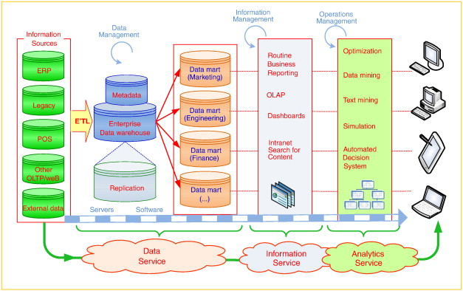
Service-Oriented DSS/BI

Slide 18
Major Components of Service-Oriented DSS/BI
Data-as-a-Service (DaaS)
Accessing data “where it lives”
Enriching data quality with centralization
Better MDM (Master Data Management), CDI (Customer Data Integration)
Access the data via open standards such as SQL, XQuery, and XML
NoSQL type data storage and processing
Amazon’s SimpleDB
Google’s BigTable

Slide 19
Major Components of Service-Oriented DSS/BI
Information-as-a-Service (IaaS)
“Information on Demand”
Goal is to make information available quickly to people, processes, and applications across the business (agility)
Provides a “single version of the truth,” make it available 24/7, and by doing so, reduce proliferating redundant data and the time it takes to build and deploy new information services
SOA(Service Oriented Architecture), flexible data integration, MDM, …

Slide 20
Major Components of Service-Oriented DSS/BI
Analytics-as-a-Service (AaaS)
“Agile Analytics”
AaaS in the cloud has economies of scale, better scalability, and higher cost savings
Data/Text Mining + Big Data → Cloud Computing
Storage and access to Big Data
Massively Parallel Processing
In-memory processing
In-database processing
Resource polling, scaling, cost and time saving, …

Slide 21
Impacts of Analytics in Organizations: An Overview
New Organizational Units
Analytics departments
Chief Analytics Officer, Chief Knowledge Officer
Restructuring Business Processes and Virtual Teams
Reengineering and BPR (Business Process Re-engineering)
Job Satisfaction
Job Stress and Anxiety
Impact on Manager Activities/Performance

Slide 22
An Overview of the Analytics Ecosystem
Analytics Industry Clusters
Data Infrastructure Data Warehouse Providers
Middleware/BI Platform Industry
Data Aggregators/Distributors
Analytics-Focused Software Developers
Application Developers or System Integrators
Analytics User Organizations
Analytics Industry Analysts and Influencers
Academic Providers and Certification Agencies

Slide 23
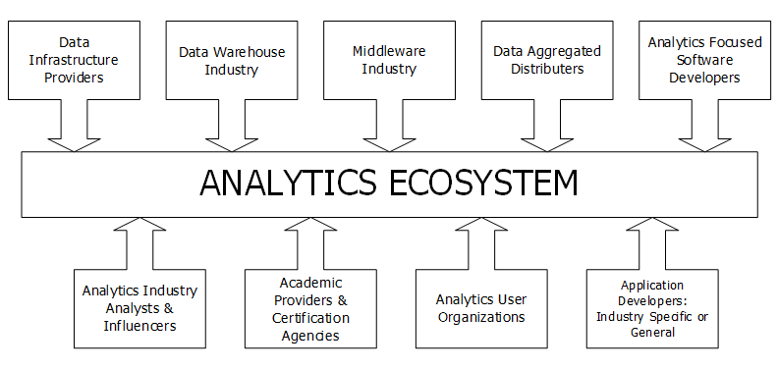
Analytics Ecosystem

